Slide 1
BloodBorne Pathogens & OSHA
Ashe County Schools

Slide 2


Slide 3
OSHA
Occupational Safety and Health Administration
Standard to reduce or eliminate health risk, resulting in:
Annual training of employees
Safe workplace environment
Exposure Control Plans

Slide 4
Exposure Control Plan
Defines who is at risk
Outlines procedures to minimize or eliminate exposures to BBP
Procedures to follow in even of exposure
  These plans are located in the nurses office, school office and CSS
  Who is covered???
    Anyone who can anticipate coming in contact with blood or body fluids while at work
    The school system is required to identify personnel whose job duties may expose them to blood or body fluids
    Everyone is required to receive information on the dangers of exposure
    Who is at risk??
    Anyone who comes in contact with human blood or body fluids
    Anyone who touches potentially contaminated surfaces or equipment
Notes:
OSHA- if they visit for an inspection, employees will be randomly be asked about BBP training, if we have a BBP Exposure Control Plan and where it is located.
You don’t have to know everything that is in it – but you do need to know where to find it!

Slide 5
Bloodborne pathogens
Organisms in blood and other body fluids that can cause disease in humans
Exposure can result in serious illness or death
Examples:
HBV- Hepatitis B Virus
HCV- Hepatitis C Virus
HIV- Human Immunodeficiency virus
AIDS- Acquired
Protect yourself!
Always use universal precautions
Treat ALL blood/bodily fluids as if infected
Follow guideline in BBP Exposure control plan

Slide 6
Workplace Transmission
Direct Transmission
From one person to another through open cut, abrasion, sore or membranes of nose, mouth, eyes containing:
  Person to person contact
  Indirect Transmission
  Touching a contaminated object or surface
    Open Cuts
    Skin Abrasions
    Mucous membranes of eyes, nose or mouth
    Airborne transmission

Slide 7

Not infectious for BBP
Feces
Urine
Tears
Saliva
Vomitus
Sputum
Sweat
***Unless visible blood***

Slide 8

Protective Measures
Treat all blood and body fluids as potentially infectious:
You can not tell when a individual has HBV, HIV
Some have no knowledge or symptoms of their disease
Universal precautions:
Wash hands with soap and water
Wash hands after removing PPE
Wear Personal Protective Equipment (PPE):
Gloves, mask, gown, eye protection (if needed)
Make sure all PPE fits appropriately and no holes/tares
Immunizations
Hepatitis B
Other Measures:
Use broom and dustpan to pick-up broken glass
Call custodian to clean-up blood and body fluids
Use sharps container to dispose of needles/syringes/lancets
Notes:
Handwashing is the single most important means of preventing the spread of infection
When to wash your hands:
Before and after touching someone or something potentially infectious
After removing gloves
after using restroom
Before eating, smoking, applying cosmetics, handling contact lens
Gloves- wear when any contact of blood or other body fluids may occur
Masks and eye protection if there is any chance of splashing into the mouth nose/eyes

Slide 9
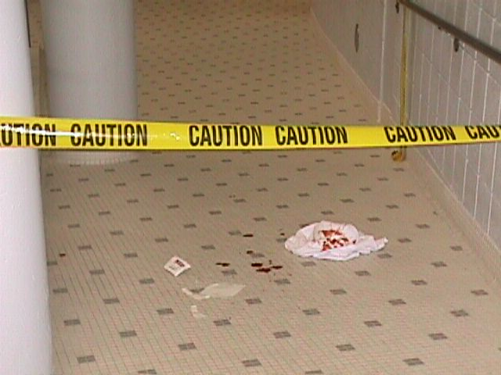
Notes:
Decontamination
Wear gloves
Towels to absorb spill
Use 10% bleach solution/saniwipes to clean area up
Place items trash bag to be removed from area of others

Slide 10

Bloodborne Pathogens of Concern
Hepatitis B
Hepatitis C
HIV/AIDS
Notes:
Hepatitis B – Infection of the liver, can lead to cirrhosis, liver cancer and death
20% risk of infection with a contaminated sharp
Virus can survive in dried blood up to 7 days
S/Sx: Hep B- Fatigue, loss of appetite, nausea, Jaundice, fever, abdominal and joint pain, 30% have no symptoms
HEP B is preventable with the Hep B vaccine
Hep B vaccine is recommended to all high risk groups, is safe, 3 shots, life long immunity
Hep C- Most common chronic blood borne infection in US, causes liver damage, cirrhosis and liver cancer, leading reason for liver transplants, 2% risk of infection by contaminated sharp
85% don’t know they are infected
NO vaccine and no cure for Hep C
HIV/AIDS
Attacks the body’s immune system, unable to fight off other infections, NO Vaccine and NO cure, 6,000 new infections daily

Slide 11
What if I am exposed?
Immediately wash your hands with soap and water
(splash mucous membranes and rinse/flush with
water for 15 min)
Have source of infection remain available
Notify supervisor and/or School Nurse
Then if needed will be guided to complete necessary paperwork/incident report and/or refer you for further treatment.

Slide 12

As a school employee you must react to emergencies not only with your heart but with your head.
Know the facts and take precautions to protect yourself.
Students, co-workers and loved ones are counting on you!
Thank you for all you do –
You are very appreciated!!

Slide 13

Questions

